Slide 1
Jermyn Borough Council Meeting
06/06/19

Slide 2
Meeting Agenda
Call to Order
Pledge of Allegiance
Roll Call
Previous Meeting Minutes
Treasurer’s Report/Bills Payable
Correspondence
Public Comment
Reports
Reports of Committees
Garbage Contract
Episcopal Church Lunch Program
Summer Activities Program
Recycling (Frank)
Recycle Coach
Business Permit Application Final Review R&L Land Sale
DPW Equipment Storage Building
New Business
Adjournment

Slide 3
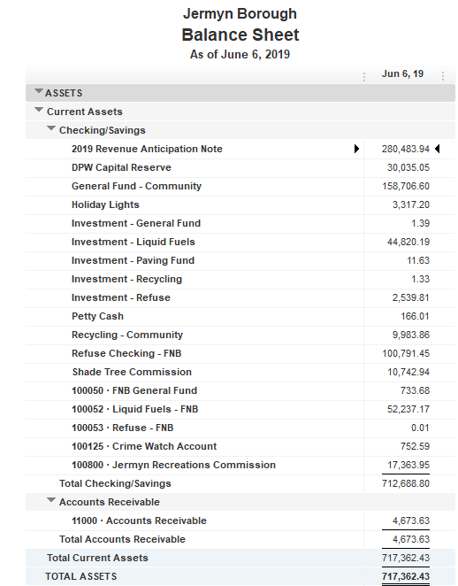
Treasurer’s Report

Slide 4
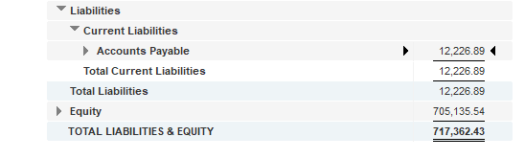

Slide 5
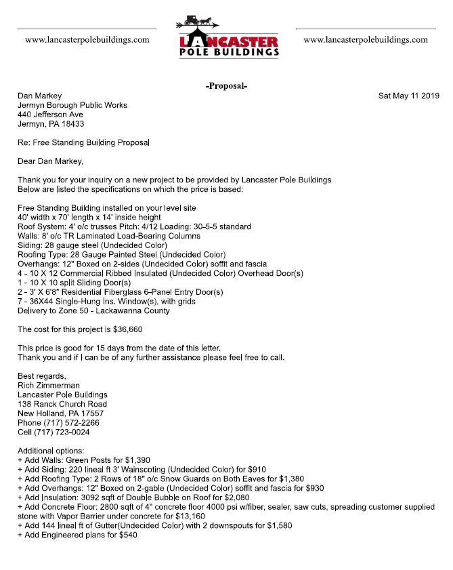

Slide 7
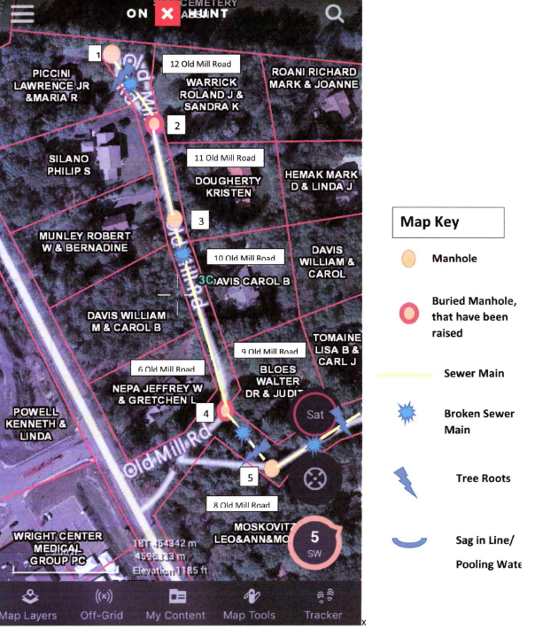

Slide 8
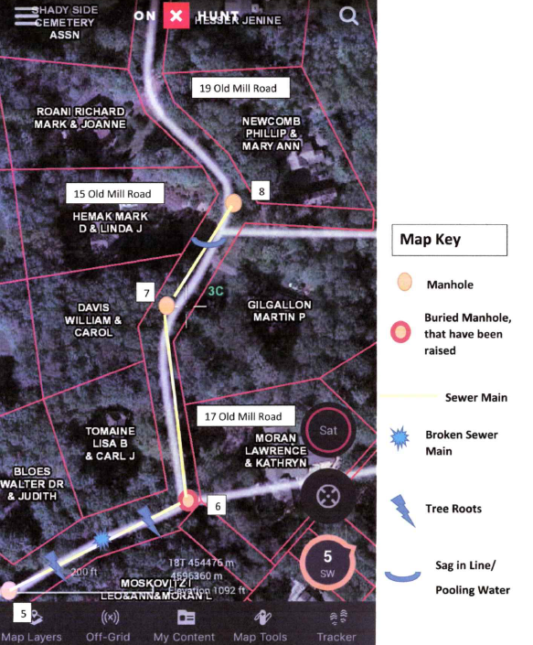

Slide 9
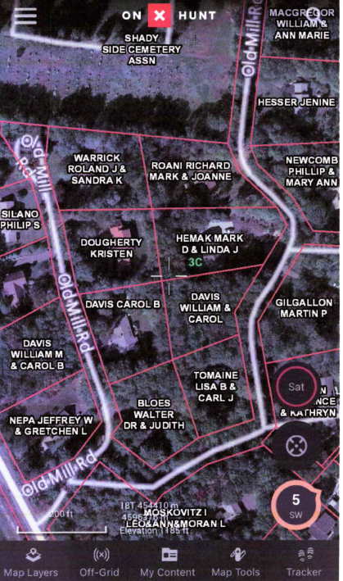

Slide 10
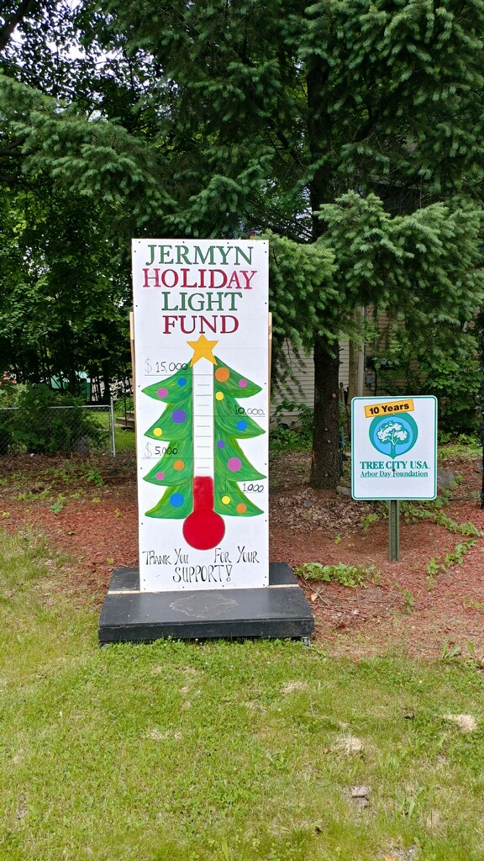

Slide 11
